Slide 1
Predictive Maintenance for Hydraulic Systems Using Machine Learning
Rock Deng 2025/2/16

Slide 2
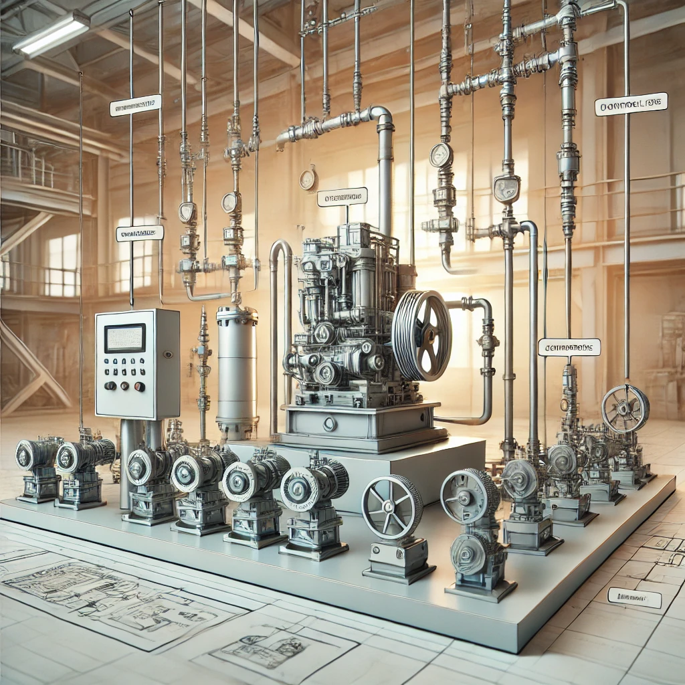
Introduction
Why Predictive Maintenance?
- Hydraulic system failures cause costly downtime.
- Preventive maintenance reduces unexpected failures and improves efficiency.
Objective:
- Develop a machine learning model to predict failures using sensor data.
Dataset:
- Condition Monitoring of Hydraulic Systems dataset.

Slide 3
Problem Statement
Current Challenges:
- Manual inspections are time-consuming.
- Unexpected failures cause operational disruptions.
- Traditional maintenance is reactive, not predictive.

Slide 4
Problem Statement
Proposed Solution:
- Utilize machine learning to classify failure risks in hydraulic systems.
- Implement efficient models for real-time monitoring.

Slide 5
Related Work
Prior Research:
- Machine learning models (Random Forests, SVMs, Neural Networks) have been tested for failure prediction.
- Feature engineering techniques (PCA, time-series forecasting) have been applied.
- Deep learning (LSTMs) has shown promise but requires high computational power.
Gaps in Research:
- Need for interpretable and computationally efficient models.
- Limited real-time deployment applications.

Slide 6
How This Project Builds on Prior Work
Enhancing Model Interpretability:
- Use explainable AI (XAI) techniques.
Lightweight Models for Real-World Deployment:
- Investigate XGBoost and Decision Trees.
Exploring Incremental Learning for Adaptive Models:
- Adjust models dynamically based on new sensor data.

Slide 7
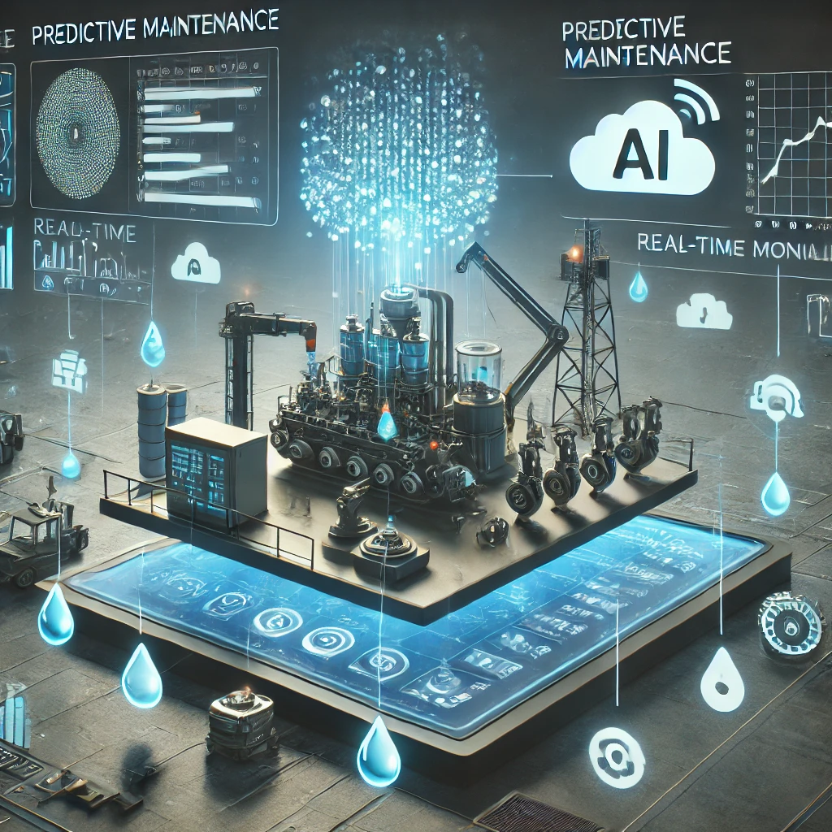
Proposed Work
Dataset & Tools:
- Condition Monitoring of Hydraulic Systems dataset.
- Python (Pandas, NumPy, Scikit-learn, TensorFlow, PyTorch).
- Time-series analysis tools (statsmodels, Prophet).
Key Steps:
1. Data preprocessing (handling missing values, normalization).
2. Model selection (Decision Trees, XGBoost, ARIMA, LSTM).
3. Performance evaluation (Accuracy, Precision, Recall, RMSE).
4. Optimizing model for real-time deployment.

Slide 8
Evaluation Plan
Metrics for Performance Measurement:
- Classification Models: Accuracy, Precision, Recall, F1-score.
- Time-Series Models: Root Mean Squared Error (RMSE).
- Efficiency: Training time and inference speed.
Comparison of Models:
- Test various models and analyze feature importance.
- Trade-off between accuracy and computational cost.

Slide 9
Project Timeline
Week 1: Dataset exploration and preprocessing
Week 2-3: Implement baseline models (Decision Trees, XGBoost)
Week 4: Experiment with time-series models (LSTM, ARIMA)
Week 5: Evaluation and performance comparison
Week 6: Final report writing and refinements

Slide 10
Thank You!
Questions?

